Slide 1
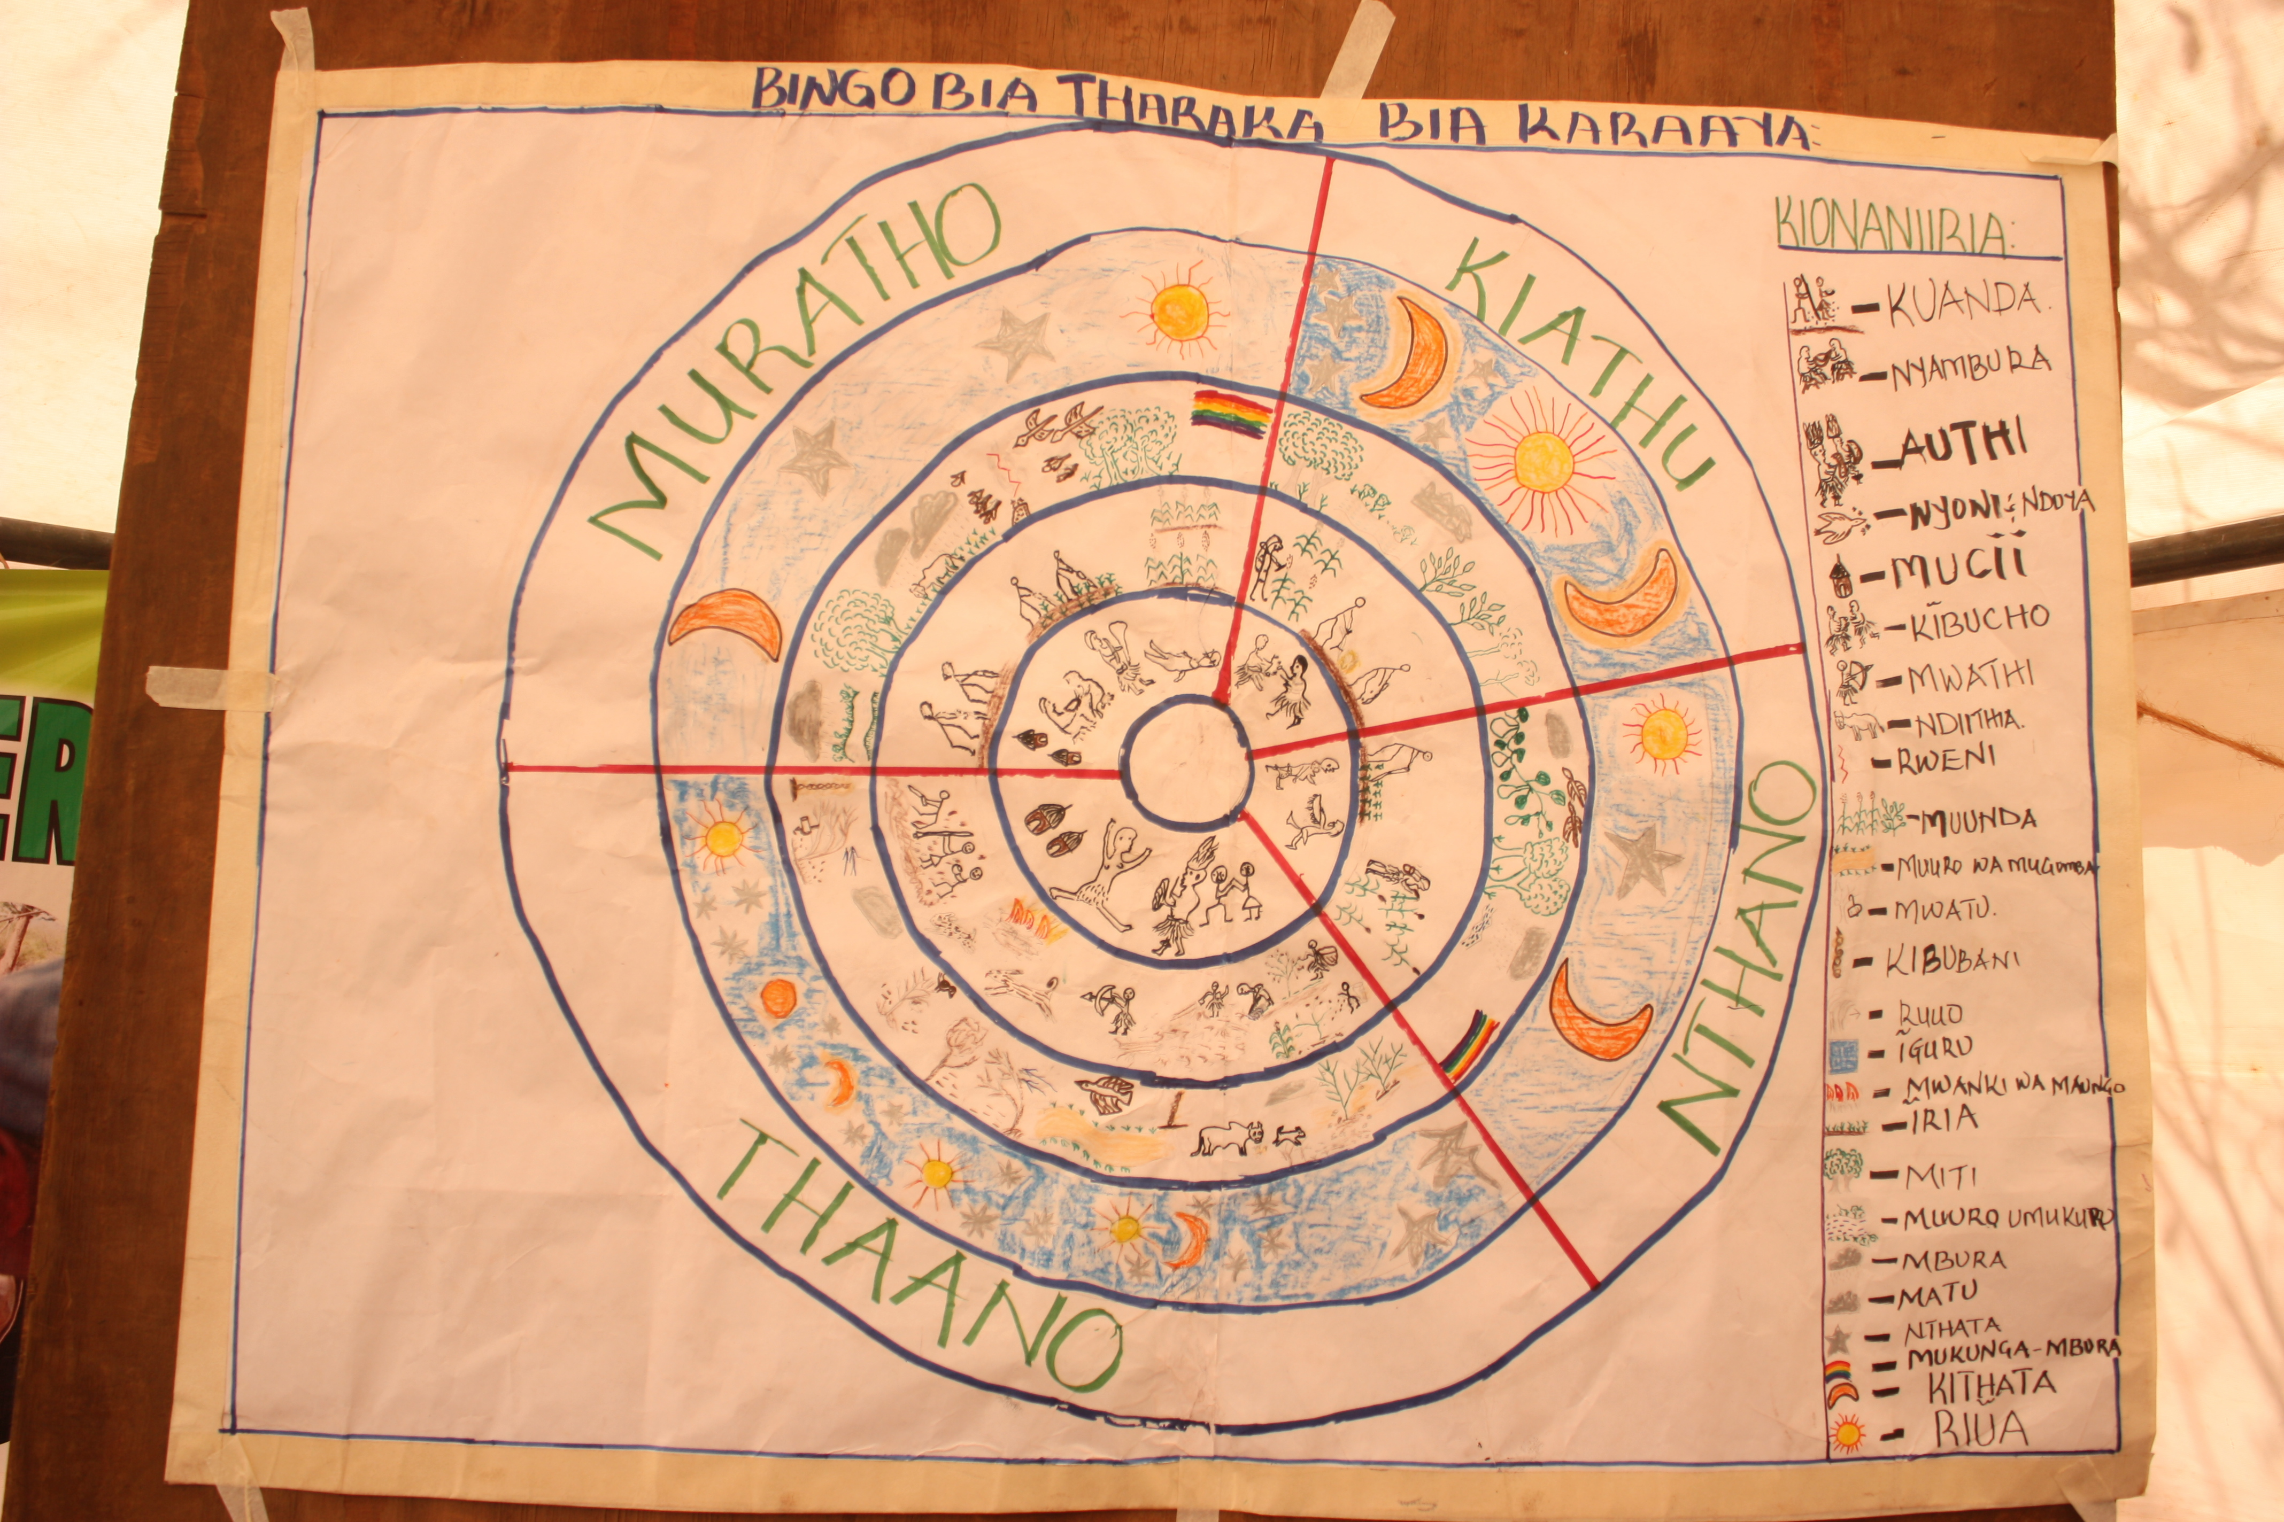
Eco-cultural mapping for mobilization of knowledge for recovering Kathita River including its sacred sites, and recognition in local planning and national biodiversity conservation
Gathuru Mburu
Institute for Culture and Ecology
June 2015

Slide 2
Objectives of the pilot
Restoration of the socio-ecological system of which Kathita River is part
Support revitalization, validation and presentation of local knowledge and experiences related to the governance of Kathita River on community’s own terms
Support initial dialogues between knowledge systems in jointly identifying and formulating the problem facing the ecosystem

Slide 3
Process approach
Preparatory stage
Community dialogues for consensus building as well as cross-generational learning
Eco-cultural approaches
Development of eco-cultural maps
Joint planning
Monitoring the river together with WARMA
Distilling traditional ecological law (TEL)
Development of seasonal eco-cultural calendar
Joint problem identification
Documenting with NMK for gazettment as sacred river
Analysis of TEL and conventional environmental law with lawyer

Slide 4
Broad-based participation
Tharaka community
Different clans with different cultural responsibilities
Custodians of sacred sites
Practitioners and government
Civil society organizations implementing environment and livelihood projects
Government administrators keen to ensure peace prevails during the process
Scientists (including social scientists)
WARMA who deal with rivers and catchment areas
Foresters and agricultural officers dealing with general environmental protection and food production
General community members
National Museums of Kenya dealing with gazettment of sacred ecosystems and cultural heritage
Lawyers and other social scientists to connect traditional ecological law and conventional law

Slide 5
Initial results
Levels of collaboration | Progress of joint work
Community + practitioners + scientists + government | Eco-cultural maps of the river with 14 sacred sites developed Eco-cultural calendars for the territory developed Draft digitized map which will enable aggregation developed Rituals on sacred sites revived Lost indigenous seeds identified and being documented
Community + WARMA + government | Joint monitoring of river to deal with illegal abstraction going on Protection of riparian reserve through tree planting going on
Community + NMK | Documentation of the story of Kathita River for gazettment as sacred and to enable further aggregation (draft report produced)
Community + lawyers | Documentation of TEL to seek its recognition as a viable body of law for use in governance of the river (process going on)
Intra-community processes | Formation of community research group to bring back lost indigenous seeds Setting up of community learning centre where relevant traditional innovations will be shared and also for co-generation of knowledge and joint work with conventional researchers (community contributing resources to set up centre)

Slide 6
Eco-cultural mapping process

Slide 7
Draft digitized map

Slide 8
Development of eco-cultural calendars

Slide 9
Reflections on:
Eco-cultural mapping
Eco-cultural calendars
Eco-cultural mapping is a potent community-driven process for mobilization of people and knowledge, which leads to people believing in the potency of their indigenous or local knowledge.
Cross-knowledge participation builds trust across knowledge systems, making joint problem definition and analysis easy.
Maps manifest the knowledge and understanding of territory and enable community-based ecosystems assessments.
Maps enable articulation of a set of rights and responsibilities for communities which are reflected in the actions.
Eco-cultural calendars support community research to revive socio-ecological systems as they embrace the whole “universe”.
Eco-cultural calendars support development of community ecological governance plans towards revival of socio-ecological systems
Eco-cultural calendars highlight cross-gender collaboration areas as they show the different but complementary roles of men and women, boys and girls. The roles of either gender need be fulfilled for those of the other gender to be useful.

Slide 10
Future work
Further digitizing eco-cultural maps to effectively contribute to aggregation of data
Support community to publish materials on their knowledge, especially traditional ecological law
Strengthening the emerging cross-knowledge collaboration at the local and national levels
Documenting experiences over 1 year of the pilot work in mobilization of local knowledge and cross-knowledge collaboration
Upscaling the process in Africa

